Slide 1
CSYE 7280 - User Experience Design and Testing
Instructor: Vishal Chawla

Slide 2
Simon Sinek – Start with why
Please listen to this talk and think about the following question for class discussion:
What is the law of diffusion of innovation? Why is it important? What separates great companies from ordinary ones?
https://www.ted.com/talks/simon_sinek_how_great_leaders_inspire_action

Slide 3


Guess the brands?
VS

Slide 4
Logo: Importance & Usage in UI
Why is Logo Design Important?
A logo can be described as the face of a company.
A logo is much more than just an image; it is a point of recognition for clients and an important foundation for the branding of your company.
A well-designed logo is an easy way to convey to potential customers that your business is professional, trustworthy, and provides quality goods or services.

Slide 5
Designing a Logo
Designing a logo for your brand/company is an iterative and multi-step process that can involve research, brainstorming, sketches, and several design concepts.
It should be effective at any size – whether it’s on a billboard or on a pen.
With logos, details are extremely important. Particular attention must be paid to every element of the logo, including colors, shapes and fonts. For ex: A gym may choose to use thick, bold fonts, while a wedding planning agency may use fanciful, cursive fonts for their logo.
The visuals and imagery should be appropriate for your company to avoid any discrepancies or confusion. It’s very important that your logo delivers the correct message about your company.

Slide 6



Logo Types
Logotype
This format includes your company’s name in stylized typeface and/or your company initials in a simple shape.
Pictorial Mark
This mark includes literal or representative imagery to symbolize your brand.
Abstract Mark
This format includes abstract shapes and symbols that convey a specific idea or attribute. These types of logos are very unique and identifiable often without the company name.

Slide 7


Emblem or Enclosure
This features the name or initials of the company, usually as part of a pictorial element or shape.
Web 2.0
Common elements typically include vibrant colors, a subtle 3D feel, bold type, color transitions, shadows, gloss and reflection.
And many more types…

Slide 8
Logo Pricing
The cost of a logo design is anywhere from $0 to tens of thousands of dollars, but if you’re a small business or startup looking for quality design, a good logo design should cost between $300-$1300.
https://99designs.com/blog/logo-branding/logo-design-cost/
Custom logo packages can wildly range not only in price—from relatively free to a few thousand dollars—but the amount of time and effort needed to get the job done.
https://www.youtube.com/watch?v=RKXZ7t_RiOE
https://medium.com/@inkbotdesign/top-10-most-expensive-logo-designs-rebrands-ever-402ea80d8f0b

Slide 9
Logo design exercise – 30 Min
Assume you were asked to design a logo for one of the following brands. What would you consider, what questions you will ask and what one or two final design would you come up with and share?
Apple
McDonalds
Facebook
Twitter
WhatsApp

Slide 10
Project team discussion
We have almost 40 students so a group of 4-5 person team would be preferred for the project
Choose a business you know, website that needs a refresh and redo the website including all aspect like mobile presence with all the user experience knowledge you learn throughout the course

Slide 11
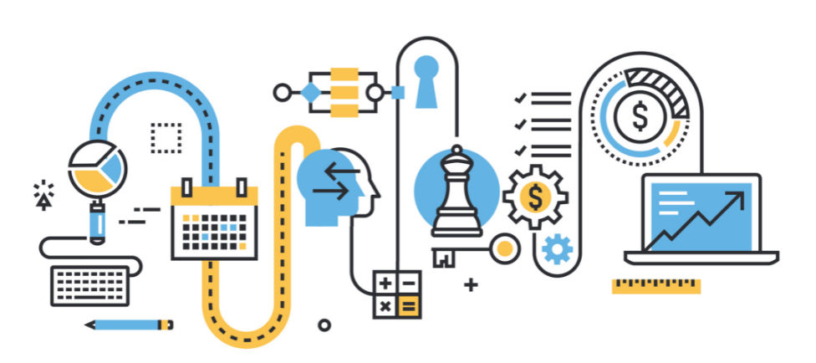
Process
A series of actions or steps taken in order to achieve a particular end. Example? How about product?

Slide 12
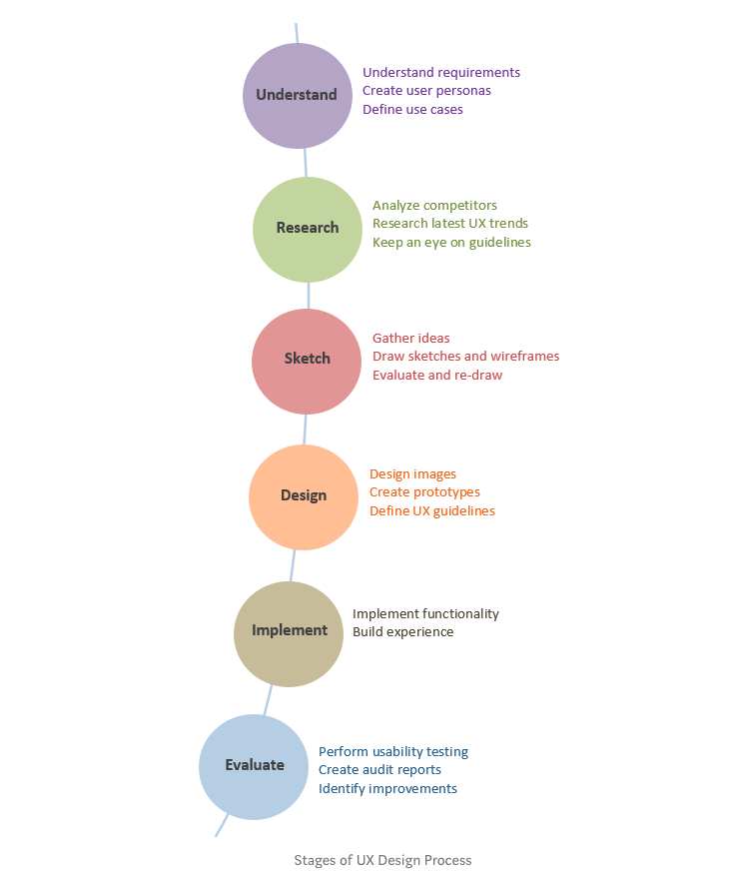

Slide 13
Strategy Plane - Discussion
Product Objectives
  Business Goals
  Brand identity – why is it important?
  Success Metrics
Choosing the right metrics for User Experience
  Success Metrics
  Conversion
  Engagement
User Needs
  User Segmentation
  Usability and User Research methods
    Surveys/interviews
    User testing
    Personas

Slide 14
Class Activity
Keeping the use cases of Assignment 1 in mind, please create 2-3 personas and scenarios.

Slide 15
Case Study – Lyft Redesign
URL: https://uxdesign.cc/lyft-re-design-case-study-3df099c0ce45
Please write your understanding of this case study and what you learned from it? Any ideas you like to propose?

Slide 16
Shopping Cart Experience Redefined
Please read following articles and think of a strategy and changes you think that which may work if you need to recreate the shopping cart experience in your website?
https://swoopnow.com/shopping-cart-abandonment/
https://www.wired.com/2014/07/keep-onecart-mobile-app/
https://theblog.adobe.com/redefining-retail-for-the-experience-era/
https://www.nngroup.com/articles/shopping-cart/

